Slide 1
Real Time Scheduling
Dynamic Priority Driven Scheduling
Earliest deadline first (EDF)

Slide 2
Fixed- and Dynamic-Priority Algorithms
Priority driven algorithms differ from each other in how priorities are assigned to jobs.
Priority driven algorithm for scheduling periodic tasks are of 2 types:
– Fixed-priority algorithm : to assign the same priority all jobs in each task
– Dynamic-priority algorithm : to assign different priorities to the individual jobs in each task.

Slide 3
Dynamic-Priority Algorithms
Dynamic-priority algorithm are of two types:
Task level dynamic-priority(Job level fixed-priority ):
Once assigned, the priority of the job does not change
-Earliest deadline first (EDF)
– To assign priorities to jobs in the tasks according to their absolute deadline
-First in, first out (FIFO)
– Job queue is first-in-first-out by release time
-Last in, first out (LIFO)
– Job queue is last-in-first-out by release time
Job level (task level) dynamic-priority : to vary the priority of a job after it has started.
-Least slack time first (LST)
– To check all ready jobs each time a new job is released and
– To order the new job and the existing jobs on their slack time
-Round Robin (RR)

Slide 4
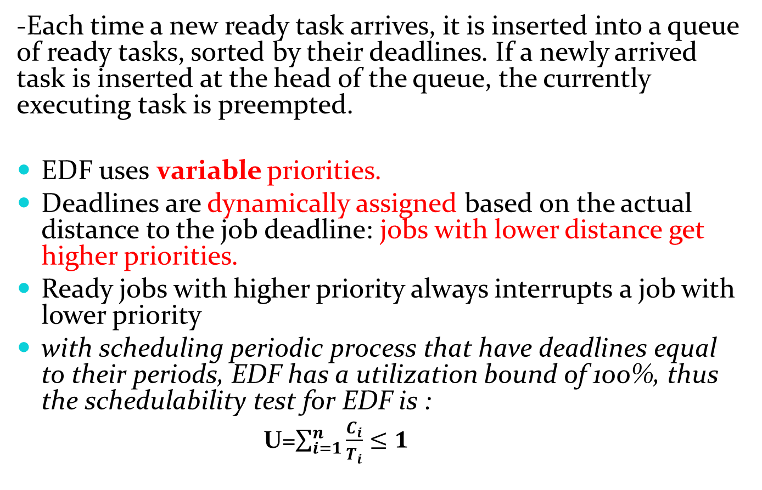
Earliest deadline first (EDF)
-Each time a new ready task arrives, it is inserted into a queue of ready tasks, sorted by their deadlines. If a newly arrived task is inserted at the head of the queue, the currently executing task is preempted.
EDF uses variable priorities.
Deadlines are dynamically assigned based on the actual distance to the job deadline: jobs with lower distance get higher priorities.
Ready jobs with higher priority always interrupts a job with lower priority
with scheduling periodic process that have deadlines equal to their periods, EDF has a utilization bound of 100%, thus the schedulability test for EDF is :
U=$\sum_{i=1}^{n}{\frac{C_{i}}{T_{i}}≤1}$

Slide 5
Earliest deadline first (EDF): Example
2 periodic task T1(2, 0.9) und T2(5, 2.3)
(Notation: T_{i}(t_{p,i} , t_{e,i}))
t=0: td,1 = 2, td,2 = 5 J1,1 executed
t=2: td,1 = 4, td,2 = 5 J1,2 executed
t=4: td,1 = 6, td,2 = 5 J2,1 executed
i.e., in interval (0, 4), T1 has the higher priority, but during interval (4, 5), T2 has the higher priority

Slide 6
Schedulability for EDF
Problem: Is there a way to determine, if a task set T is feasible for EDF without constructing the schedule?
Theorem 4.2 (EDF schedulability condition)
Under standard assumptions, a set T of n tasks is executable using EDF if and only if:
With other words: in EDF, all task sets with a load less/equal of 1 are feasible

Slide 7
Optimality for EDF
Theorem
When preemption is allowed and jobs do not contend for resources, the EDF algorithm can produce a feasible schedule of a set J of jobs with arbitrary release times and deadlines on a processor if and only if J has feasible schedules.
Proof intuition: Any feasible schedule of J can be transformed into an EDF schedule

Slide 8
Optimality for EDF
Basis
Parts of J_{i} and J_{k} are scheduled in intervals I_{i} and I_{k}
d_{i} > d_{k} but I₁ is earlier that I₂
Case 1: r_{k} later than (or equal to) the end of I₁
Jobs are already scheduled based on EDF. Hence no need to reschedule it.

Slide 9
Optimality for EDF
Case 2
r_{k} is before end of I₁
solution: swap J_{i} and J_{k} and fit parts into I₁ and I₂ like:
Step 1: (i) swap J_{k} with J_{i}
(ii) if I1 is shorter than I₂, obtain the schedule of fig (b)
(iii) if I₁ is longer than I₂, J_{k} and first part of J₁ are scheduled in I₁, last part of J₁ is scheduled in I₂
Step 2: repeat step 1 for all pairs
Step 3: eliminate the idle states: fig (c)
Step 4: Final schedule is EDF schedule.

Slide 10
Optimality for EDF
Fig (a)
Fig (b)
Fig (c)

Slide 11
As long as feasible schedule exists, every feasible schedule can be transformed into preemptive EDF schedule.
If the EDF algorithm fails to produce a feasible schedule, then no feasible schedule exists.

